Slide 1
Finding Signals in Financial Markets
Adam Roszkiewicz 51309
Lena Kryczka 41132

Slide 2
Specific Objectives:
Creating and analyzing signals for a variety of financial assets.
Measuring the efficiency of signals across multiple timeframes.
Evaluating strategy outcomes using metrics like Sharpe ratio, drawdown analysis, and trade success rate.

Slide 3
Methodology and data
Dataset: Historical price data (2010–2023) sourced from Yahoo Finance.
Key Metrics Evaluated:
Sharpe Ratio: Evaluates returns adjusted for risk.
Maximum Drawdown: Measures the steepest decline from a peak to a trough.
Win Rate: Calculates the proportion of successful trades.
Approach: Implementing a Moving Average Crossover strategy with 20-day and 50-day averages.

Slide 4
Trend-following
Trend-following is a trading strategy that aligns with the market’s movement. It operates on the premise that asset prices often sustain a directional momentum over time.
Trend-following techniques rely on technical tools to detect when a trend starts and ends.

Slide 5
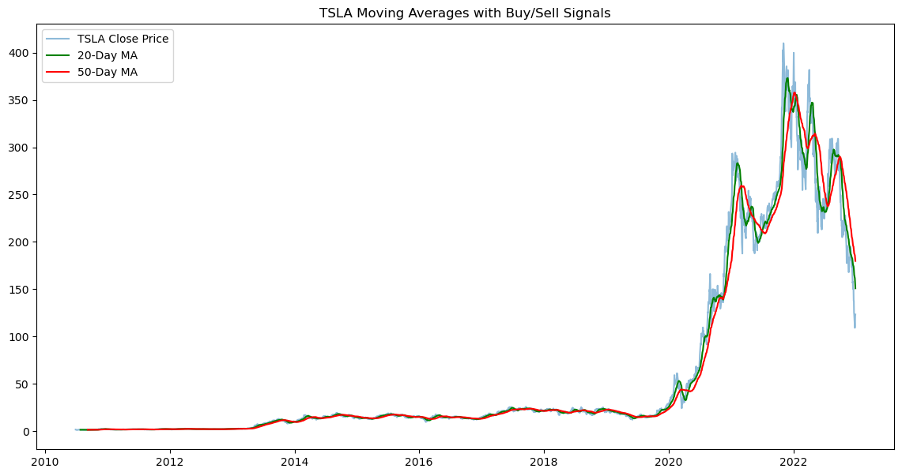
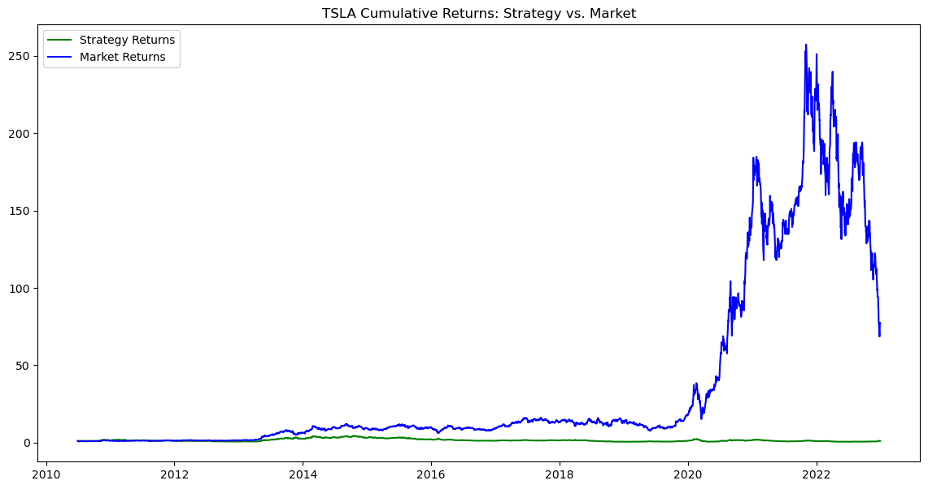
Signals Visualisation
Performance for TSLA:
Sharpe Ratio: 0.28
Maximum Drawdown: -89.35%
Win Rate: 50.47%
Total Trades: 3101
Profitable Trades: 1565

Slide 6
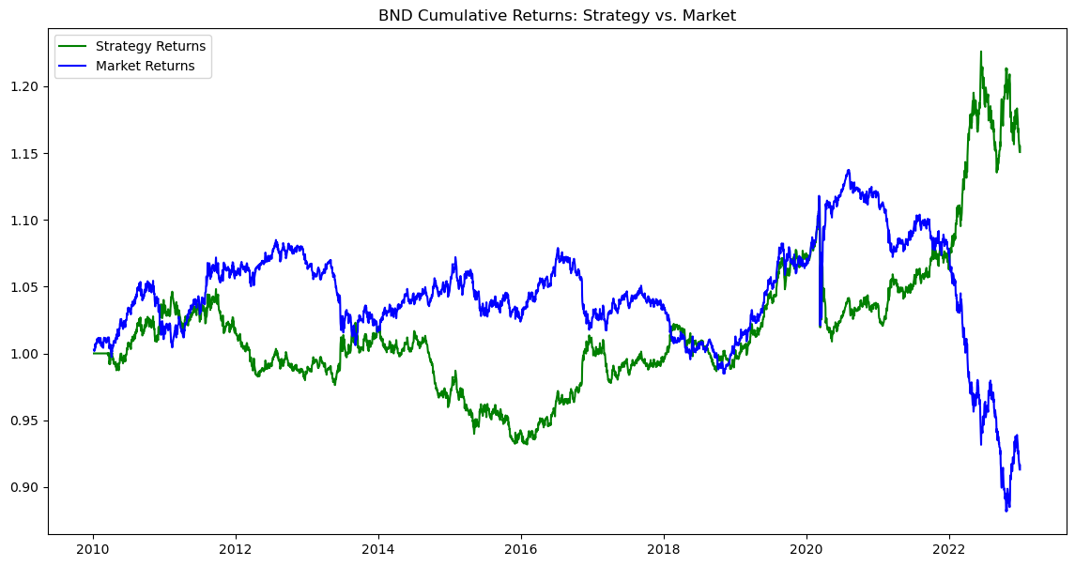
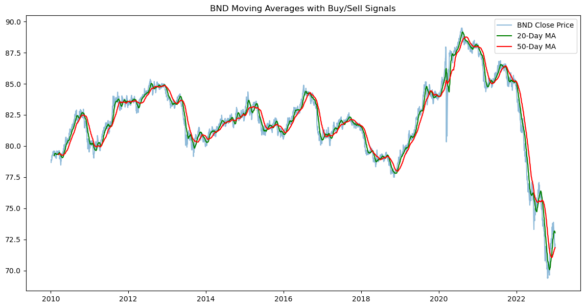
Performance for BND: Sharpe Ratio: 0.26 Maximum Drawdown: -11.10% Win Rate: 49.39% Total Trades: 3223 Profitable Trades: 1592

Slide 7
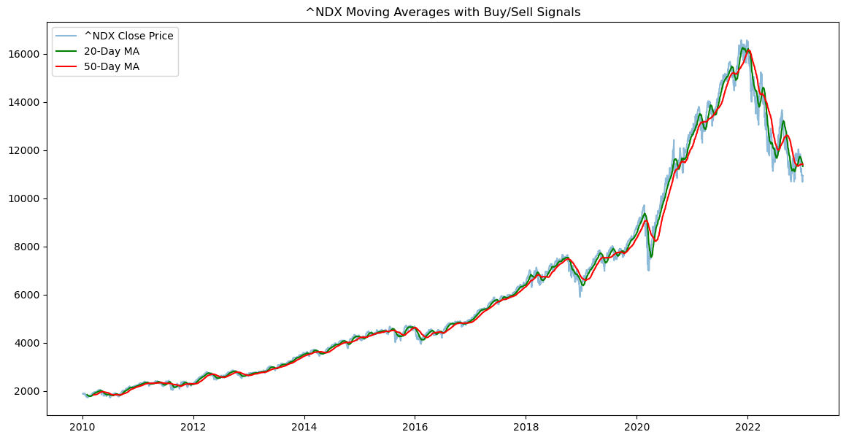
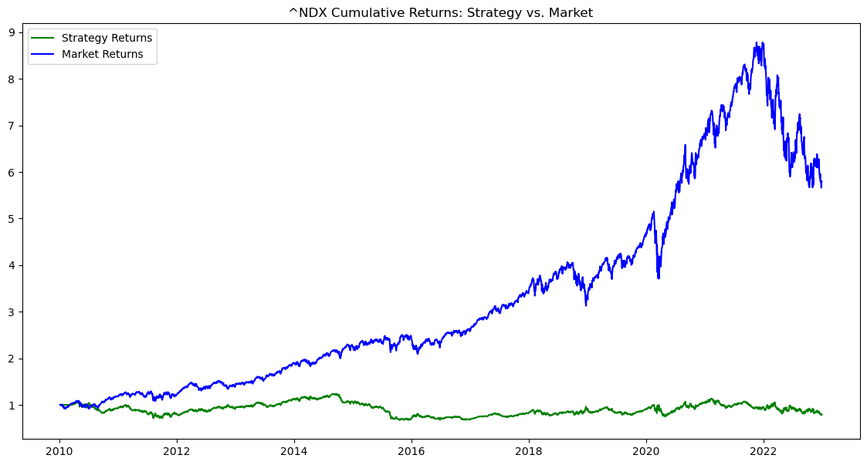
Performance for ^NDX: Sharpe Ratio: 0.02 Maximum Drawdown: -45.65% Win Rate: 52.06% Total Trades: 3223 Profitable Trades: 1678

Slide 8
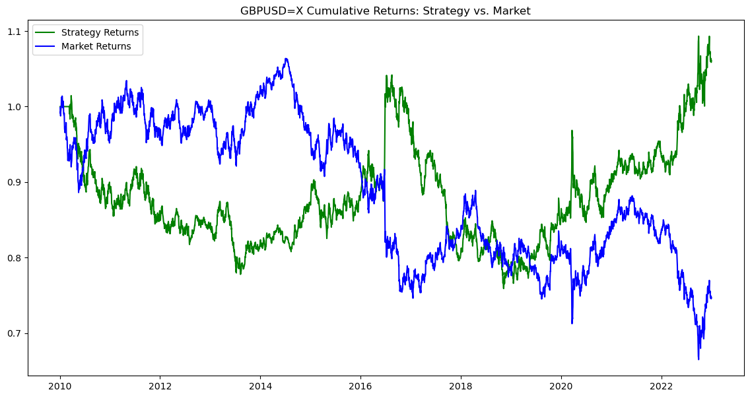
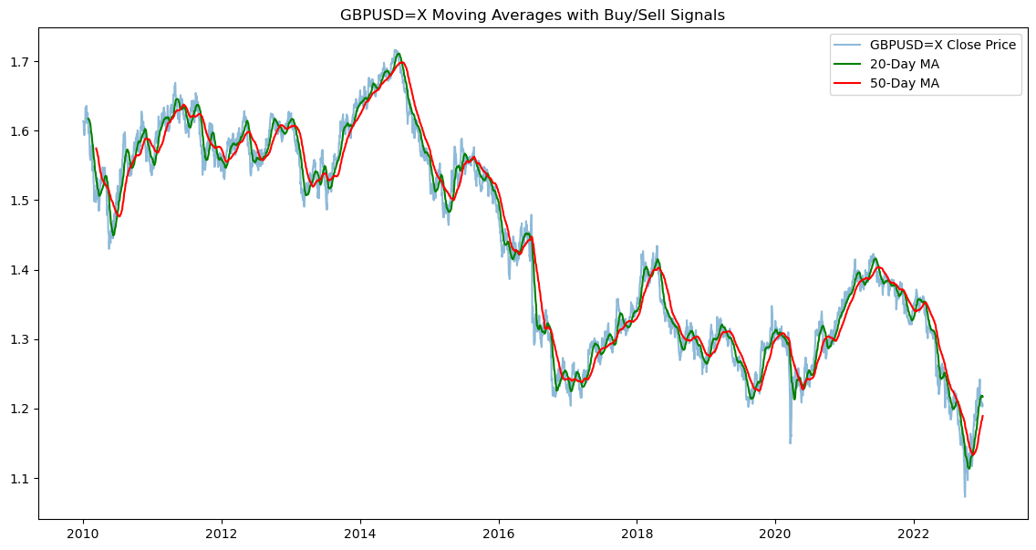
Performance for GBPUSD=X: Sharpe Ratio: 0.09 Maximum Drawdown: -27.15% Win Rate: 50.19% Total Trades: 3337 Profitable Trades: 1675

Slide 9
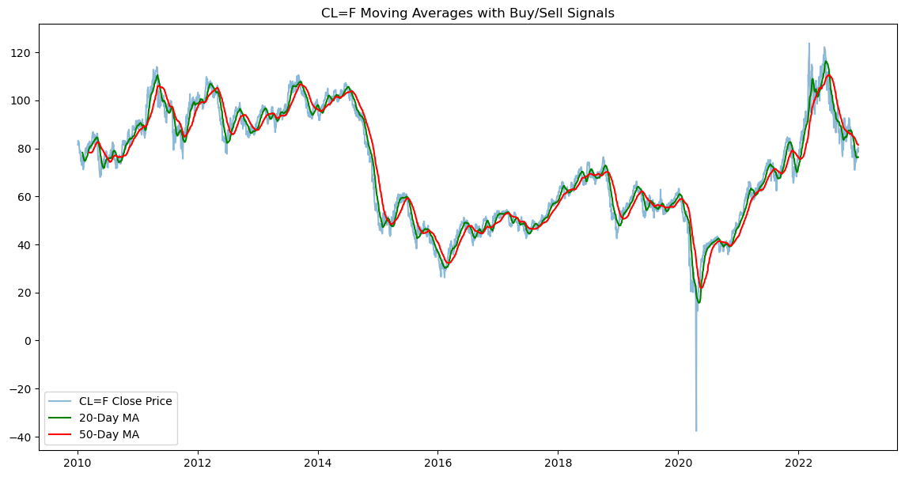
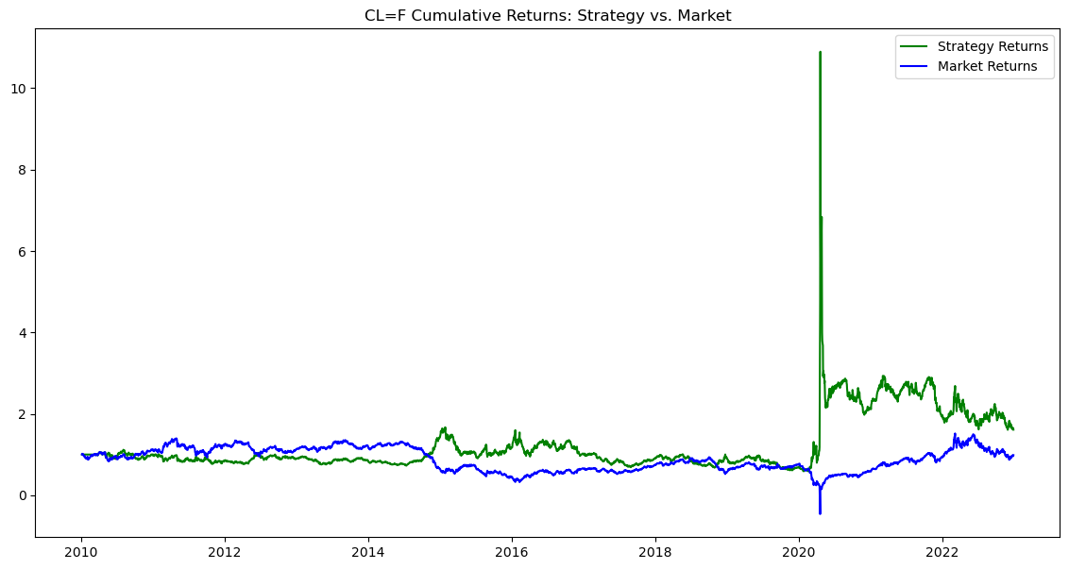
Performance for CL=F: Sharpe Ratio: 0.29 Maximum Drawdown: -85.24% Win Rate: 50.70% Total Trades: 3221 Profitable Trades: 1633

Slide 10

Thank You

